Slide 1
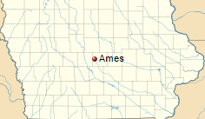
Ames House Pricing with Advanced Regression
Zohreh Soltani
Mentor: Ryan Knuffman

Slide 2
Data
The data used in this analysis includes the house sale prices from 2006 until 2010.
This dataset includes 1460 Rows and 81Features
43 Categorical and 38 Numerical columns.
Data types include 43 Objects, 35 Int 64 and 3 Float 64 ( no need to fix them)
Numerical features:
['Id', 'MSSubClass', 'LotFrontage', 'LotArea', 'OverallQual', 'OverallCond', 'YearBuilt', 'YearRemodAdd', 'MasVnrArea', 'BsmtFinSF1', 'BsmtFinSF2', 'BsmtUnfSF', 'TotalBsmtSF', '1stFlrSF', '2ndFlrSF', 'LowQualFinSF', 'GrLivArea', 'BsmtFullBath', 'BsmtHalfBath', 'FullBath', 'HalfBath', 'BedroomAbvGr', 'KitchenAbvGr', 'TotRmsAbvGrd', 'Fireplaces', 'GarageYrBlt', 'GarageCars', 'GarageArea', 'WoodDeckSF', 'OpenPorchSF', 'EnclosedPorch', '3SsnPorch', 'ScreenPorch', 'PoolArea', 'MiscVal', 'MoSold', 'YrSold', 'SalePrice']
Categorical features:
['MSZoning', 'Street', 'Alley', 'LotShape', 'LandContour', 'Utilities', 'LotConfig', 'LandSlope', 'Neighborhood', 'Condition1', 'Condition2', 'BldgType', 'HouseStyle', 'RoofStyle', 'RoofMatl', 'Exterior1st', 'Exterior2nd', 'MasVnrType', 'ExterQual', 'ExterCond', 'Foundation', 'BsmtQual', 'BsmtCond', 'BsmtExposure', 'BsmtFinType1', 'BsmtFinType2', 'Heating', 'HeatingQC', 'CentralAir', 'Electrical', 'KitchenQual', 'Functional', 'FireplaceQu', 'GarageType', 'GarageFinish', 'GarageQual', 'GarageCond', 'PavedDrive', 'PoolQC', 'Fence', 'MiscFeature', 'SaleType', 'SaleCondition']

Slide 3
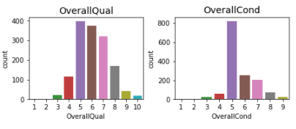
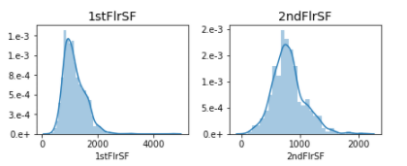
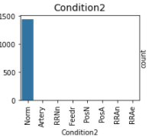
Exploratory Data Analysis (EDA)
based on the data some features "(i.e. "Street", "RoofMatl", "Heating", "GarageQual", ,"GarageCond“, “ Condition2”, Utilities, ) have a dominant category so they cannot have much explanatory power.
Distribution of the features were explored. Below are some examples.
Non normal distribution
Dominant Category

Slide 4
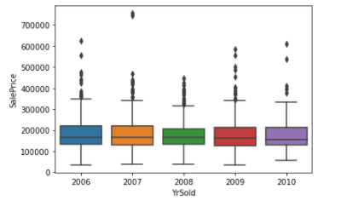
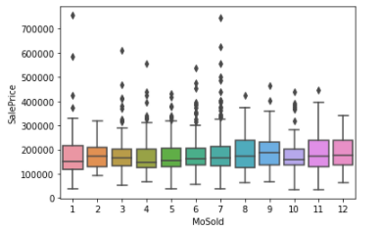
Exploratory Data Analysis (EDA)
I took closer look to some features such as YearBuilt and MoBuilt:
Based on the data it seems the Ames house market did not crash in 2008 crisis

Slide 5
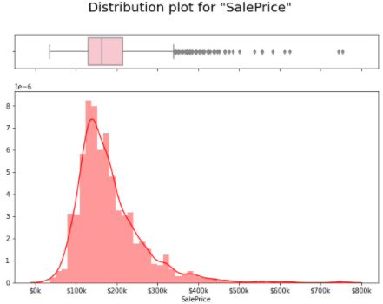
Exploratory Data Analysis (EDA)
Distribution of Sale Price which is our Target Variable:

Slide 6
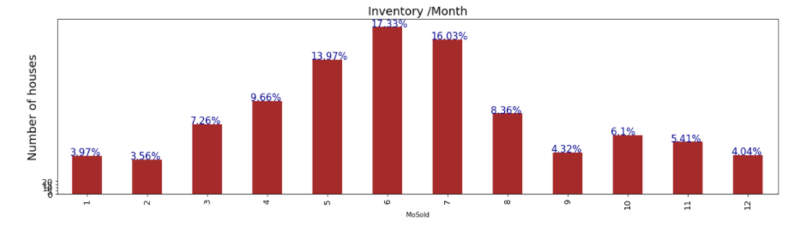
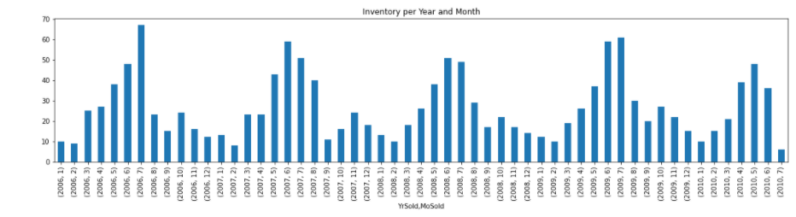
Exploratory Data Analysis (EDA)
We notice seasonality here

Slide 7
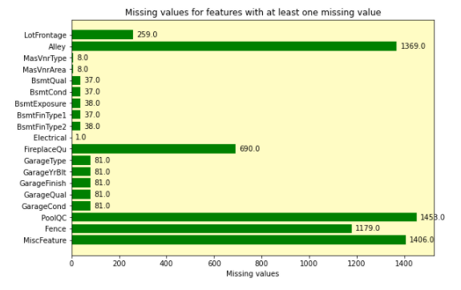
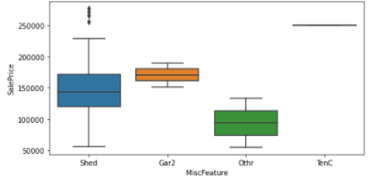
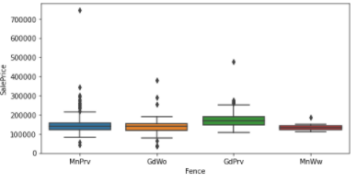
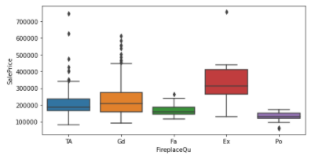
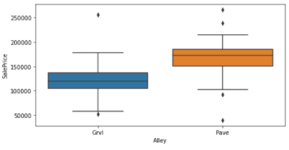
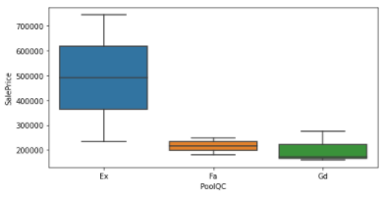
Feature Engineering
Missing Value:
I am going to drop Alley, MiscFeatures, Fence, FireplaceQu from the dataset. Missing value for the rest of the features will be replace by zero

Slide 8
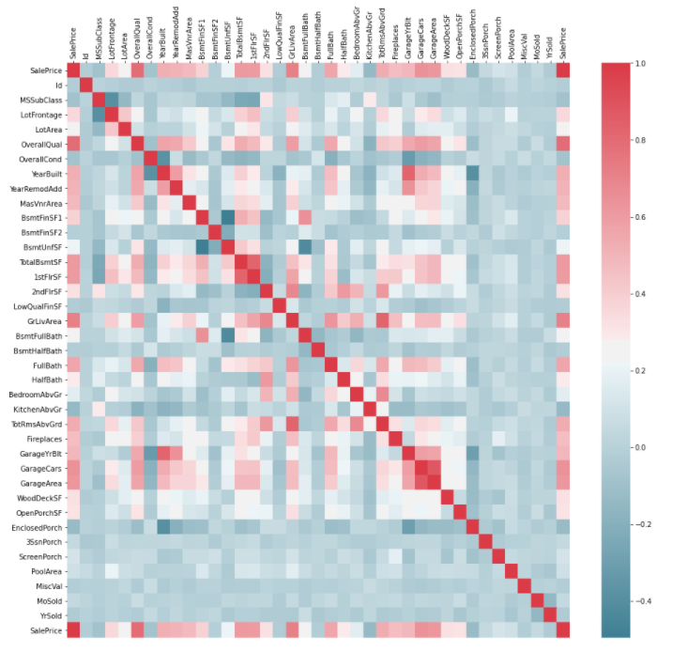
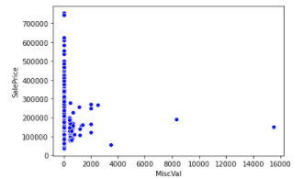
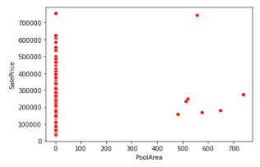
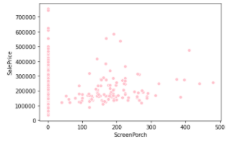
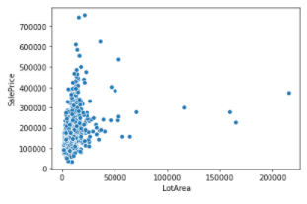
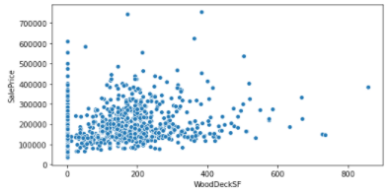
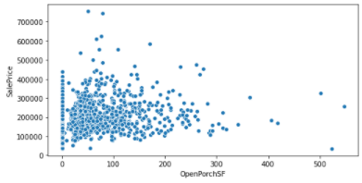
Circled features have very low correlation with Sale Price:
LotArea, LotFrontage,BsmtUnfSF, 2ndFlrSF, BsmtHalfBath, HalfBath, BedroomAbvGr, WoodDeckSF, OpenPorchSF, ScreenPorch, PoolArea

Slide 9
Multi-collinearity and numeric coding:
With 0.8 as the threshold for the collinearity among the features, following features will be dropped from the dataset before modeling and 66 features will be left for the modeling.
Before modeling, categorical data were turned into numeric values.
Model#2: Random Forest
Exterior1st, Exterior2nd, TotalBsmtSF, 1stFlrSF, GrLivArea, TotRmsAbvGrd, GarageCars, GarageAre

Slide 10
Modeling Steps:
performing Grid Search for Hyper-parameters tuning
Defining a model with best parameters from step 1
Training the train data set
Predicting the Sale Price for the test data set
Calculating the model Score

Slide 11
Model#1: XGB Boosting Regressor
Scores:
Most Important Features:
OverallQual, ExterQual, FullBath, BsmtQual, FirePlace, CentralAir, KitchenQual, GarageCond, BsmtFinSF1, BsmtFullBath
RMSE: 27433.531236
R_squared: 0.878213
Adjusted_R_squared: 0.847897

Slide 12
Model#2: Random Forest
Scores:
RMSE: 28303.840234
R_squared: 0.870363
adjusted_R_squared: 0.835981
Most Important Features
OverallQual, ExterQual, KitchenQual, BsmtQual, BsmtFinSF1, FullBath, 2ndFlrSF, CentralAir, KitchenQual, GarageCond, BsmtFullBath

Slide 13
Model#3: Ridge Regression
0.782701
Scores:
RMSE: 36644.600190
R_squared: 0.782701
adjusted_R_squared: 0.728609

Slide 14
Conclusion and recommendation:
0.782701
Random forest and Xgboosting have similar scores and identify similar features as th emost important one in predicting the Sale Price
Ridge Regression is not as accurate as Xgboosting and Randomforest
having outlier and non normal data is impacting the performace of the Ridge Regression
to improve the scores my recommendation is spending more time in the feature engineering to remove outlier data, transform the nonmoral features and eliminate more features that donot have exploratory power

